Slide 1
Lists:
The list can be defined as an abstract data type in which the elements are stored in an ordered manner for easier and efficient retrieval of the elements.
List Data Structure allows repetition that means a single piece of data can occur more than once in a list. In the case of multiple entries of the same data, each entry of that repeating data is considered as a distinct item or entry.
It is very much similar to the array but the major difference between the array and the list data structure is that array stores only homogenous data in them whereas the list (in some programming languages) can store heterogeneous data items in its object.

Slide 2
List Data Structure is also known as a sequence.
The list can be called Dynamic size arrays, which means their size increased as we go on adding data in them and we need not to pre-define a static size for the list.
For example,
numbers = [ 1, 2, 3, 4, 5]
In this example, 'numbers' is the name of the List Data Structure object and it has five items stored in it. In the object named numbers, we have stored all the elements of numeric type. In the list, the indexing starts from zero, which means if we want to access or retrieve the first element of this list then we need to use index zero and similarly whenever we want to access any element from this list named numbers. In other words, we can say that element 1 is on the index 0 and element 2 is on index 1 and similarly for further all elements.

Slide 3
mixed_data = [205, 'Nirnay', 8.56]
In this second example, mixed_data is the name of the list object that stores the data of different types. In the mixed_data list, we have stored data of three types, first one is the integer type which is id '205', after the integer data we have stored a string type data having the value 'Nirnay' stored at index 1 and at last the index value 2, we have stored a float type data having the value '8.56'.
To access the elements of the mixed_data list, we need to follow the same approach as defined in the previous example.
We can add more data to these defined List objects and that will get appended at the last of the list. For example, if we add another data in the mixed_data list, it will get appended after the float value object having value '8.56'. And we can add repeating values to these list-objects.

Slide 4
Various operations on the List Data Structure:
The various operations that are performed on a List Data Structure or Sequence are:
Add or Insert Operation: In the Add or Insert operation, a new item (of any data type) is added in the List Data Structure or Sequence object.
Replace or reassign Operation: In the Replace or reassign operation, the already existing value in the List object is changed or modified. In other words, a new value is added at that particular index of the already existing value.
Delete or remove Operation: In the Delete or remove operation, the already present element is deleted or removed from the Dictionary or associative array object.
Find or Lookup or Search Operation: In the Find or Lookup operation, the element stored in that List Data Structure or Sequence object is fetched.

Slide 5
Linear list:
A linear list, is defined as a sequence of nodes together with a set of operations on those nodes.
The term "node" can be thought of as something carrying some information; it might be a person's health record, a playing card, or simply an integer.
The essential feature of a linear list is the fact that it is a sequence of nodes.
If there are n nodes in the list, we can write the sequence as Xl, X2, ... , Xn where Xl is the first node, X2 is the second, and so on, with Xn being the last node.

Slide 6
The operations that we might want to perform on a linear list will vary from one situation to another. They might include:
examine the contents of the node at one end of the list
insert or delete a node at one end of the list
insert a new node before or after a node containing some key
delete the kth node
alter the contents of the kth node
search for a node that contains some value
sort the nodes of the list based on some key

Slide 7
There are a number of possible implementations of lists.
The most basic question is whether to use;
sequential allocation (meaning storing the elements sequentially in an array) or
linked allocation (meaning storing the elements in a linked list).
With linked allocation there are many other options to be considered;
Is the list singly linked (each node pointing to its successor in the list),
doubly linked (each node pointing to both its successor and predecessor),
circularly linked (with the last node pointing back to the first)

Slide 8
sequential allocation:
A list is allocated memory in a sequential manner.
This means that the elements of the list are stored in memory in the sequence of their declaration.
So if you want to view the fifth element of the list you have to first traverse through the first four elements of the list.
This is called sequential allocation of memory.

Slide 9
Linear list:
A linear list is a type of data structure that represents a collection of elements, or items, arranged in a sequential order.
In a linear list, each element is connected to its adjacent elements in a linear fashion, such that there is only one path through the list.
Linear lists are commonly used in computer programming for a variety of applications, including data storage, sorting, searching, and manipulation.
They can be implemented using various data structures, such as arrays, linked lists, and stacks.

Slide 10
Arrays are a type of linear list that store elements in contiguous memory locations, which makes accessing elements in the list fast and efficient. However, arrays have a fixed size, which can limit their flexibility.
Linked lists, on the other hand, are dynamic data structures that can grow or shrink as needed, but accessing elements in the list can be slower than with arrays.

Slide 11
Stacks are a special type of linear list that allow elements to be added and removed from only one end, known as the top of the stack.
Linear lists can be used to represent a variety of data types, such as numbers, characters, strings, and objects.
Liner list are useful in many applications such as sorting, searching and storing data.
However they have some limitations such as fixed size( for fixed sized arrays) and slow access time for insertion and deleting elements (for linked list).
They are often used as a building block for more complex data structures, such as trees and graphs."

Slide 12
General Linear List:
A general linear list is a data structure in computer science and programming that consists of a sequence of nodes, each of which contains a data element and a reference to the next node in the sequence.
The nodes can be located anywhere in memory, and they are connected by the next reference.
The term "general" indicates that the list can have any number of nodes, and it is not restricted to a fixed size or capacity.
The "linear" aspect of the list refers to the fact that the nodes are arranged in a linear sequence, with each node having only one predecessor and one successor.

Slide 13
General linear lists can be implemented using various data structures, such as arrays or linked lists.
They are commonly used in many applications, including data storage, graph algorithms, and file systems.

Slide 14
Differences between linear list and general linear list:
A linear list and a general linear list are both data structures used in computer science and programming.
However, there is a fundamental difference between the two;
A linear list is a data structure in which elements are arranged in a sequential order, where each element is connected to its adjacent element by a link or a pointer.
This means that in a linear list, each element has only one predecessor and one successor, except for the first and last elements, which have only one predecessor or successor, respectively.

Slide 15
On the other hand, a general linear list is a data structure that allows each element to have any number of predecessors and successors.
In other words, in a general linear list, a node can have multiple references to other nodes, which enables it to form complex data structures such as trees, graphs, and networks.
Therefore, the primary difference between a linear list and a general linear list is that a linear list only allows for a simple sequence of elements, while a general linear list allows for more complex and interconnected structures.

Slide 16


Examples:

Slide 18
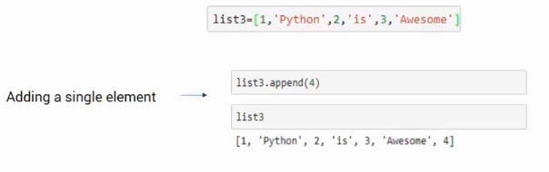
A single element can be added using an append function.

Slide 19
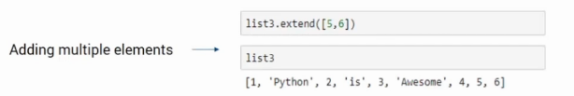

Slide 20
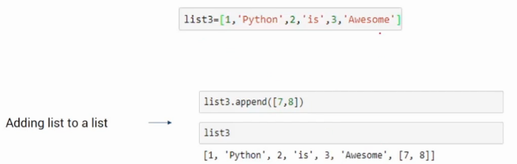

Slide 21
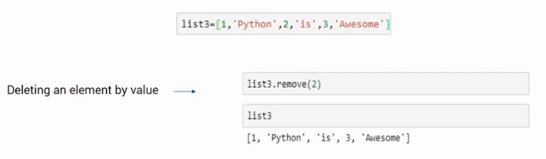

Slide 22


Slide 23
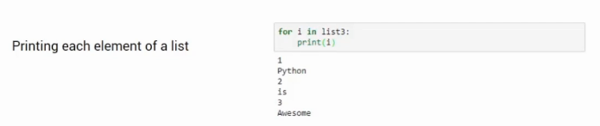

Slide 24
Linked list:
A linked list is a linear data structure used for storing and manipulating a sequence of elements.
It is a collection of nodes, where each node contains both a data element and a reference (or pointer) to the next node in the sequence.
Linked lists are dynamic data structures that allow for efficient insertion and deletion of elements, especially when compared to arrays or other static data structures.

Slide 25
This is because inserting or deleting an element in a linked list only requires updating the reference pointers of a few nodes, whereas in an array, it may require shifting many elements.
Linked lists are commonly used in various computer science applications such as implementing;
stacks,
queues and
hash tables.
However, they can also have some disadvantages, such as the lack of random access and the potential for memory fragmentation.

Slide 26
It consists of a sequence of nodes, where each node contains a piece of data and a pointer to the next node in the sequence.
The first node in the sequence is called the head node, while the last node in the sequence has a pointer to null.
The basic building block of a linked list is a node, which contains two fields: a data field to store the element and a next field to store the address of the next node in the sequence.
The next field of the last node in the sequence is set to null, indicating the end of the list.
Linked lists are dynamic data structures, which means that they can grow or shrink in size during the execution of a program.
They are particularly useful in situations where the size of the data is not known in advance, or where the data needs to be inserted or deleted frequently.

Slide 27
Linked lists come in different variations, including singly linked lists, doubly linked lists and circular linked lists.
Singly linked lists have nodes that only point to the next node in the sequence.
Doubly linked lists have nodes that point to both the next and previous nodes in the sequence.
Circular linked lists have nodes that form a circular sequence, where the last node points back to the head node.

Slide 28
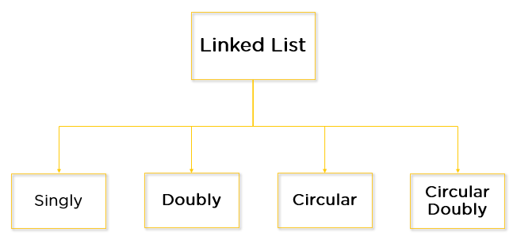
In a singly linked list, each node only has a reference to the next node, while in a doubly linked list, each node has references to both the next and the previous nodes.
However, they have some disadvantages compared to other data structures, such as arrays, including slower random access time and higher memory overhead.

Slide 29
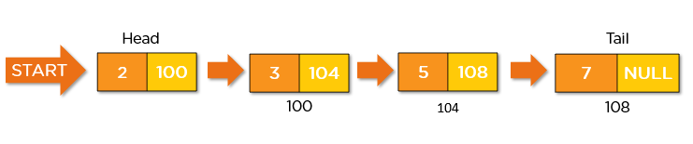
Singly linked list

Slide 30

Doubly linked list

Slide 31
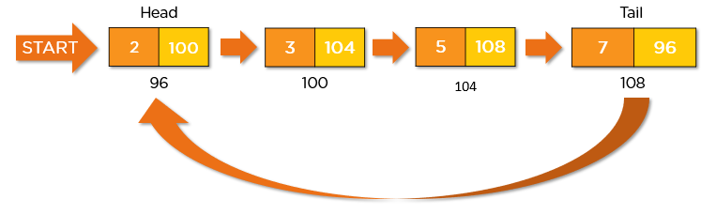
Circular linked list:

Slide 32
Data feeding in linked list
To feed data into a linked list, you need to create nodes and connect them together to form the list.
Here are the general steps to create and initialize a singly linked list:
Create a node class that represents a single node in the linked list.
The node class should have two attributes: data, which stores the element, and next, which points to the next node in the list.
Create a head pointer that points to the first node in the list.
Initially, the head pointer is set to null.
To add a new node to the list, create a new node with the element to be added and set its next pointer to null.

Slide 33
If the head pointer is null, set it to point to the new node.
If the head pointer is not null, traverse the list from the head node to the end node, and set the next pointer of the last node to point to the new node.
Here's an example Python code to create a singly linked list and feed data into it:
class Node:
def __init__(self, data):
self.data = data
self.next = None
# Create the head pointer and initialize it to null
head = None

Slide 34
# Add the elements 1, 2, 3 to the list
for i in range(1, 4):
# Create a new node with the element
new_node = Node(i)
# If the list is empty, set the head pointer to the new node
if head is None:
head = new_node
else:
# Traverse the list to the end and add the new node
current = head
while current.next is not None:
current = current.next
current.next = new_node

Slide 35
In this code, Node is a class that represents a single node of the linked list.
The __init__ method initializes the data and next attributes of the node.
The code then creates the head pointer and initializes it to null.
It uses a for loop to add the elements 1, 2, and 3 to the list.
For each element, it creates a new node with the element and sets its next pointer to null.
If the list is empty (i.e., the head pointer is null), it sets the head pointer to the new node.
Otherwise, it traverses the list from the head node to the end node and sets the next pointer of the last node to point to the new node.
After the loop completes, the linked list contains the elements 1, 2, and 3, in that order.

Slide 36
Data retrieval from a Linked list:
To retrieve data from a linked list, you need to traverse the list from the head node to the node that contains the desired data.
Here are the general steps to retrieve data from a singly linked list:
Set a current pointer to the head node of the list.
While the current pointer is not null, check if the data in the current node matches the desired data.
If the data matches, return the data.
If the data does not match, set the current pointer to the next node in the list and continue the loop.
If the loop completes without finding the data, the data is not in the list.

Slide 37
Here's an example Python code to retrieve data from a singly linked list:
class Node:
def __init__(self, data):
self.data = data
self.next = None
# Create the head pointer and initialize it to null
head = None
# Add the elements 1, 2, 3 to the list
for i in range(1, 4):
# Create a new node with the element
new_node = Node(i)

Slide 38
# If the list is empty, set the head pointer to the new node
if head is None:
head = new_node
else:
# Traverse the list to the end and add the new node
current = head
while current.next is not None:
current = current.next
current.next = new_node

Slide 39
# Search for the element 2 in the list
current = head
while current is not None:
if current.data == 2:
print("Element found!")
break
current = current.next
if current is None:
print("Element not found.")
else:
print("Element found at node:", current)

Slide 40
In this code, the Node class and the creation of the linked list are the same as the previous example.
The code then sets the current pointer to the head node and loops through the list, checking if the data in each node matches the desired data (in this case, the element 2).
If the data is found, the code prints a message and breaks out of the loop.
If the loop completes without finding the data, the code prints a different message indicating that the data is not in the list.

Slide 41
How to create a list by recursion:
To create a list by recursion, you can define a recursive function that creates each element of the list and calls itself to create the next element.
Here are the general steps to create a list by recursion:
Define a recursive function that takes an index or counter variable as an argument.
In the function, create a new node with the desired data for the current index.
If the index is equal to the desired length of the list, return the node.
If the index is less than the desired length of the list, set the next pointer of the current node to the result of calling the recursive function with the next index.
In the main code, call the recursive function with an initial index of 0.

Slide 42
Here's an example Python code to create a singly linked list of length 5 by recursion:
class Node:
def __init__(self, data):
self.data = data
self.next = None
def create_list_recursively(index, length):
if index == length:
return None
node = Node(index)
node.next = create_list_recursively(index + 1, length)
return node

Slide 43
head = create_list_recursively(0, 5)
current = head
while current is not None:
print(current.data, end=' ')
current = current.next

Slide 44
In this code, the create_list_recursively function takes an index and a length as arguments.
The base case of the recursion is when the index equals the length, in which case the function returns None.
Otherwise, the function creates a new node with the current index and sets its next pointer to the result of calling itself recursively with the next index.
In the main code, the create_list_recursively function is called with an initial index of 0 and a length of 5.
The resulting linked list is stored in the head variable.
The code then traverses the list and prints the data in each node, separated by spaces.
The output of this code should be: 0 1 2 3 4.

Slide 45
Creating a list by iteration:
To create a list by iteration, you can use a loop to create each element of the list and link it to the previous element.
Here are the general steps to create a list by iteration:
Create a new node with the desired data for the first element of the list.
Set the head pointer to point to the first element.
Use a loop to create the remaining elements of the list.
In each iteration of the loop, create a new node with the desired data and link it to the previous element of the list.
Update the tail pointer to point to the new node.

Slide 46
After the loop completes, set the next pointer of the last node to None.
Here's an example Python code to create a singly linked list of length 5 by iteration:
class Node:
def __init__(self, data):
self.data = data
self.next = None
head = Node(0)
tail = head
for i in range(1, 5):
new_node = Node(i)
tail.next = new_node
tail = new_node

Slide 47
tail.next = None
current = head
while current is not None:
print(current.data, end=' ')
current = current.next
In this code, the Node class is the same as in the previous example.
The code first creates the first element of the list and sets the head and tail pointers to point to it.

Slide 48
The code then uses a loop to create the remaining elements of the list.
In each iteration of the loop, the code creates a new node with the current index as its data, links it to the previous node using the next pointer, and updates the tail pointer to point to the new node.
After the loop completes, the code sets the next pointer of the last node to None.
Finally, the code traverses the list and prints the data in each node, separated by spaces.
The output of this code should be: 0 1 2 3 4.

